Slide 1


EPL SCORE PREDICTIONS
CS 302: Artificial Intelligence
Zaiyr Sharsheev, COM-18

Slide 2


The purpose of my project is to predict the score of the match based on the past games of these clubs since 1993. The time interval can be adjusted in the code, because since 1993 the balance of power of football clubs has changed a lot. I am a big fan of English football so I was very interested in this topic. Based on these results, you can roughly understand who is the favorite of the match. Although football is an unpredictable game, I think all fans of this sport would be interested to see the estimated score of the match and its percentage of the possible outcome.

Slide 3


TOOLS AND PROGRAMMING LANGUAGE
This project is based on developing an EPL (English Premier League) Football Matches Predictions using Python Programming Language and Jupyter Notebook (an open-source web application that allows to create and share documents that contain live code, equations, visualizations and narrative text)

Slide 4
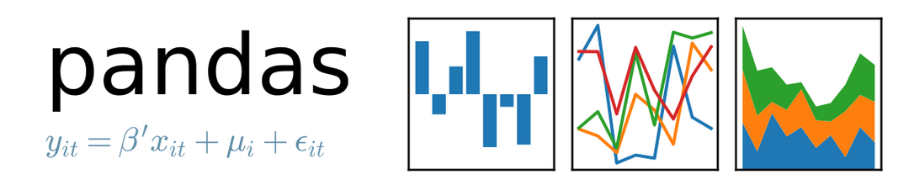


Which libraries did I use?

Slide 5
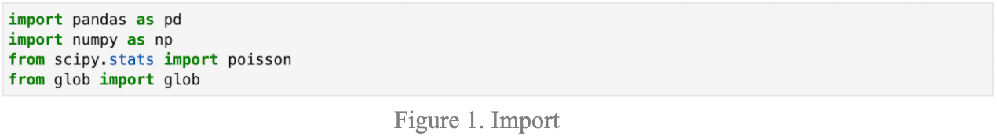
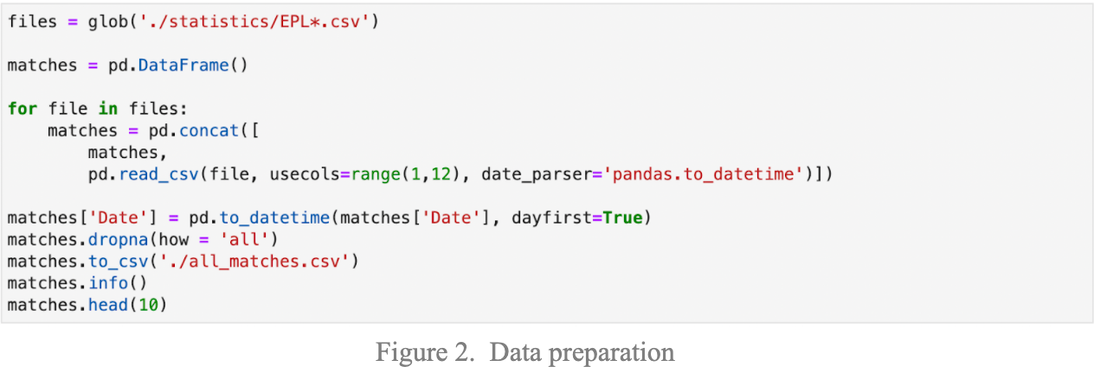
Source Code

Slide 6
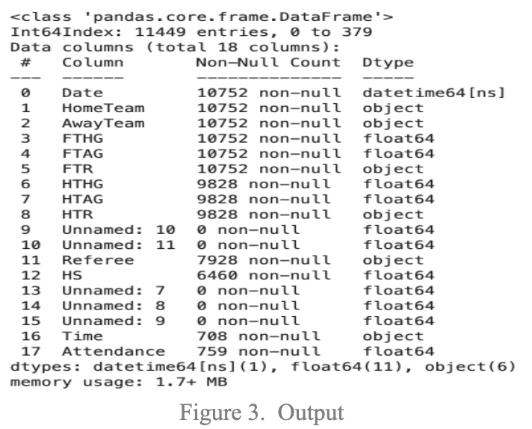
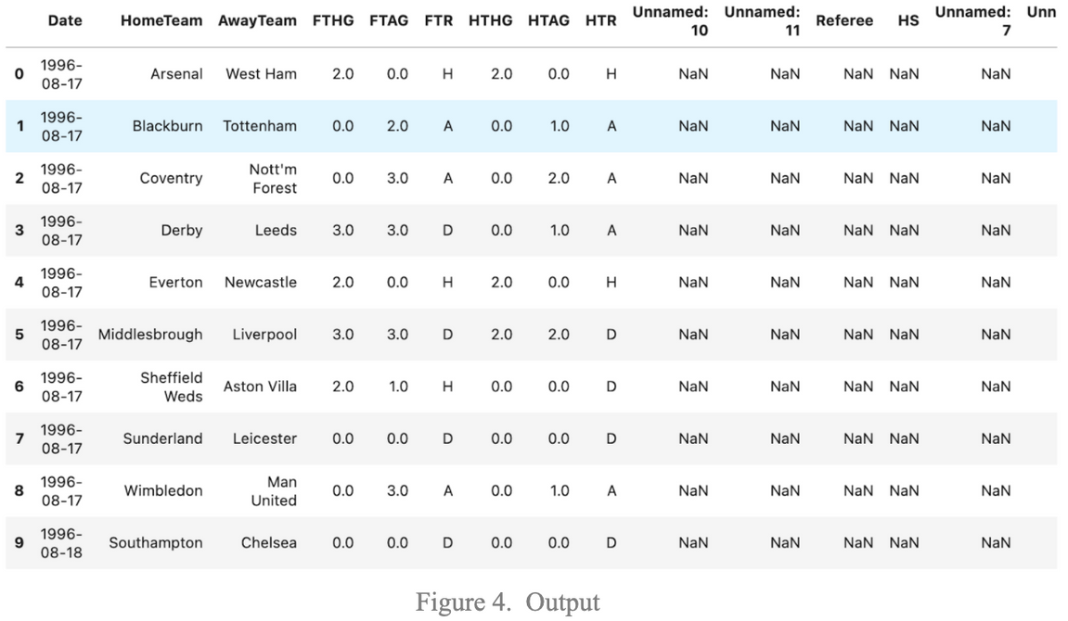
Source Code

Slide 7
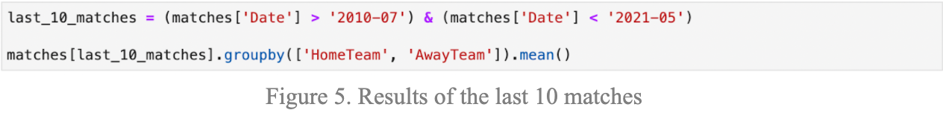
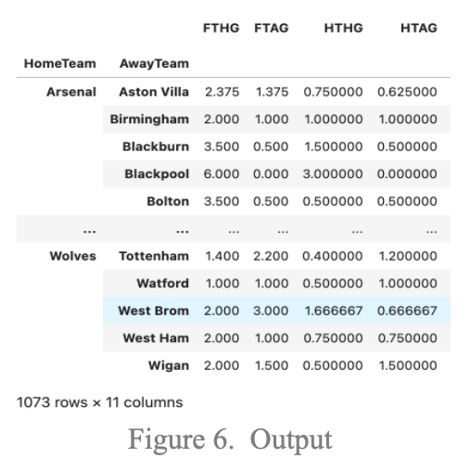
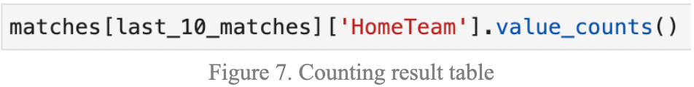
Source Code

Slide 8
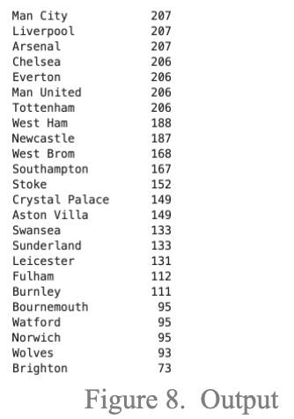
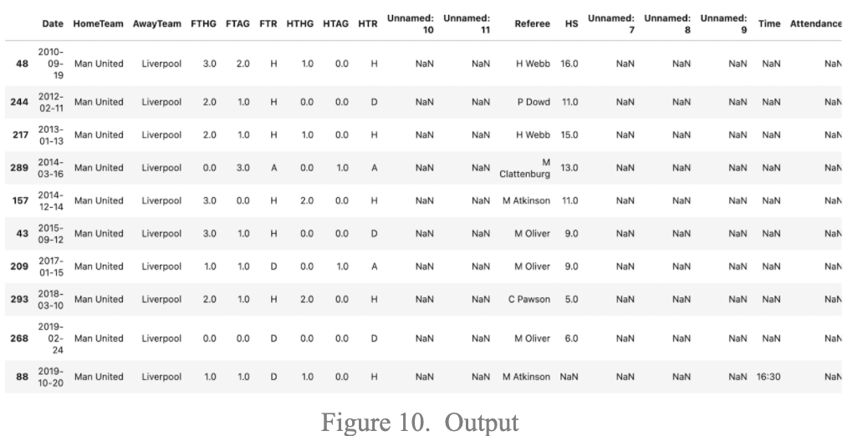
Source Code

Slide 9
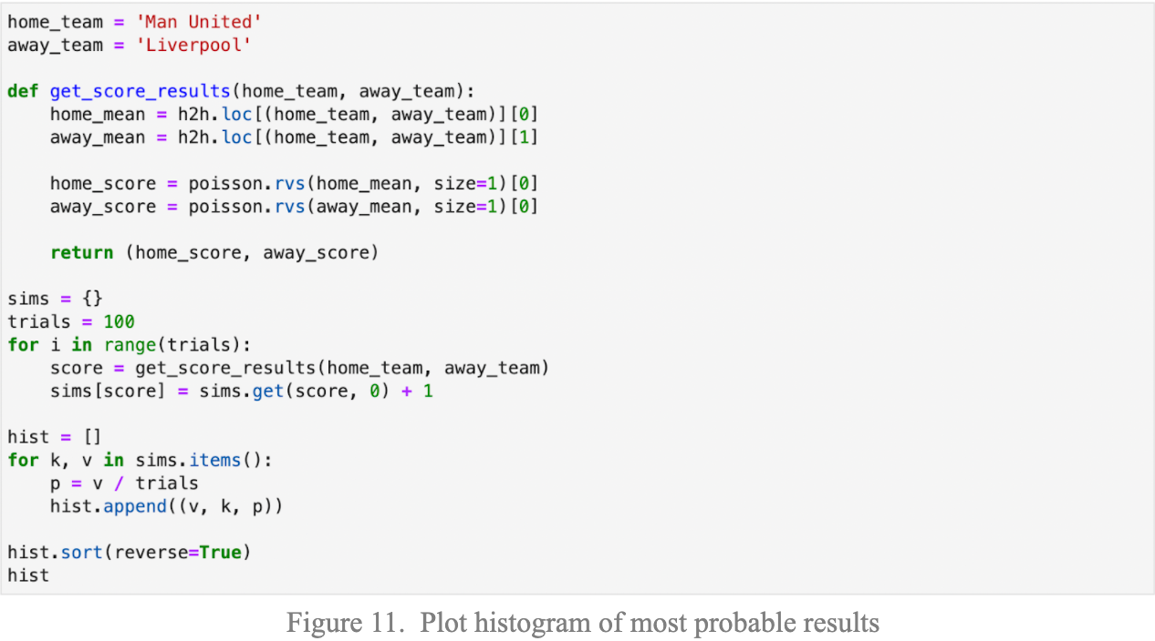
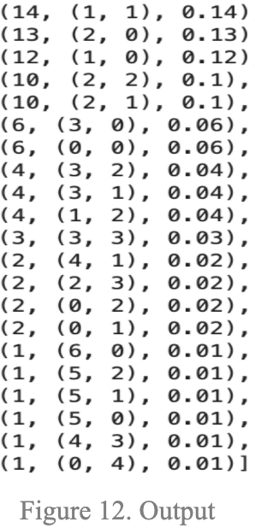
Source Code

Slide 10
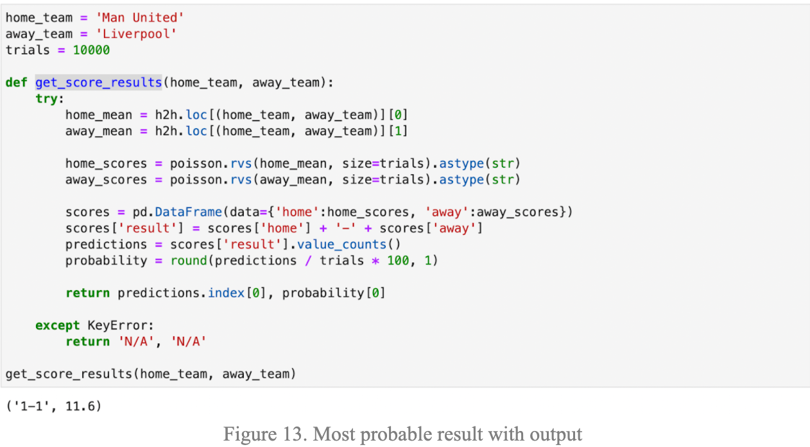
Source Code

Slide 11
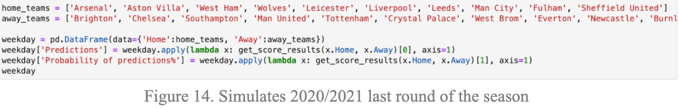
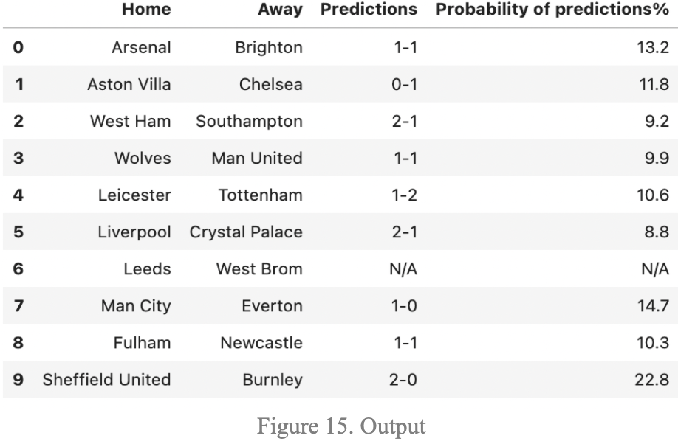
Source Code

Slide 12

THANK YOU
FOR ATTENTION!

